Slide 1
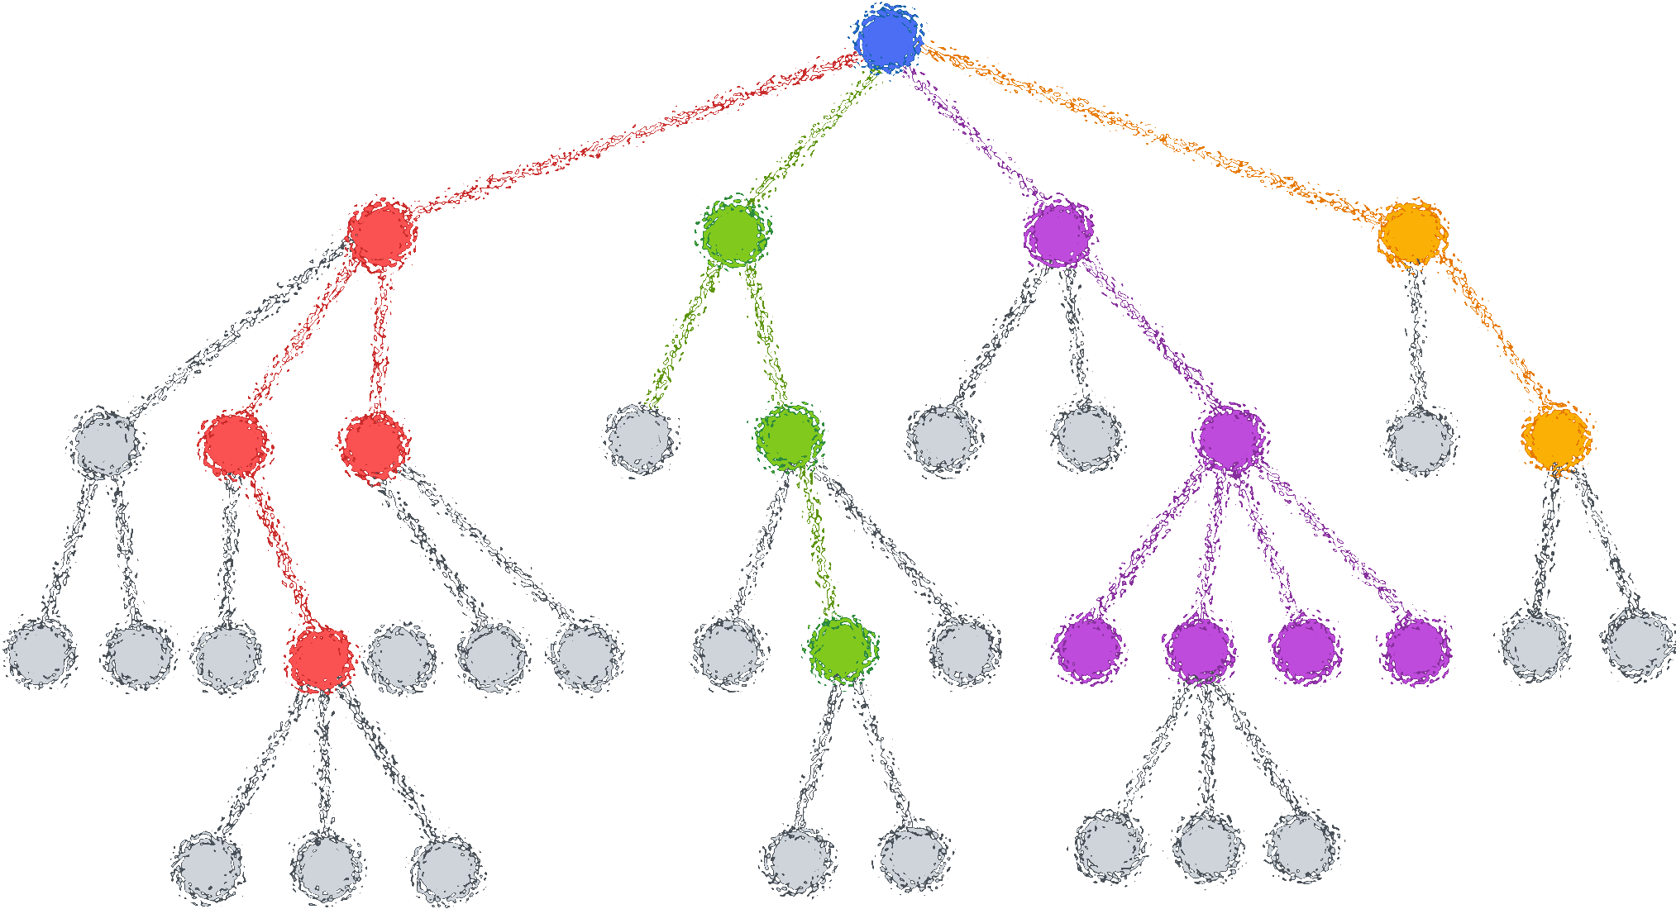

Lecture 9: Decision Tree (Classification)
CSE445 Machine Learning
Dr. Jilan Samiuddin (JSA)
Assistant Professor
North South University

Slide 2
Introduction
A decision tree is a supervised learning algorithm used for both classification and regression tasks
It mimics human decision-making by splitting data into branches at decision points (nodes) to reach a final prediction (leaf)
Think of it like a flowchart:
Classification Trees: Predict categories (e.g., "spam" or "not spam").
Regression Trees: Predict continuous values (e.g., house prices).

Slide 3
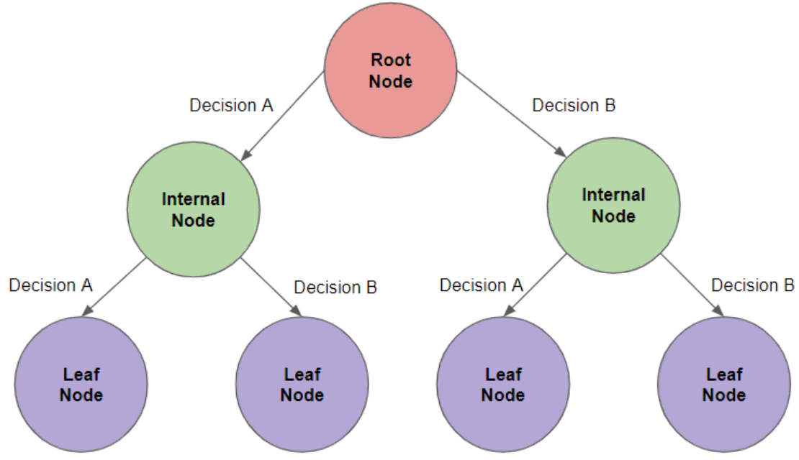
Key Terms/Components
Root Node
The topmost decision point
Uses the most informative feature to split the data
Example: In a dataset predicting loan approval, the root might split based on "Income > $50k?"
Internal Nodes
Decision points after the root
Further split data based on feature conditions
Example: After splitting by income, an internal node might check "Credit Score > 700?"
Leaf Nodes
Final nodes containing predicted outcomes
No further splitting occurs here
Example: "Approve loan" or "Reject loan"

Slide 4
Some Applications of Decision Trees
Healthcare: Diagnosing diseases based on symptoms
Finance: Credit risk assessment and fraud detection
Marketing: Customer segmentation (e.g., "Will this user buy Product X?")
Manufacturing: Quality control (e.g., "Is this product defective?")

Slide 5
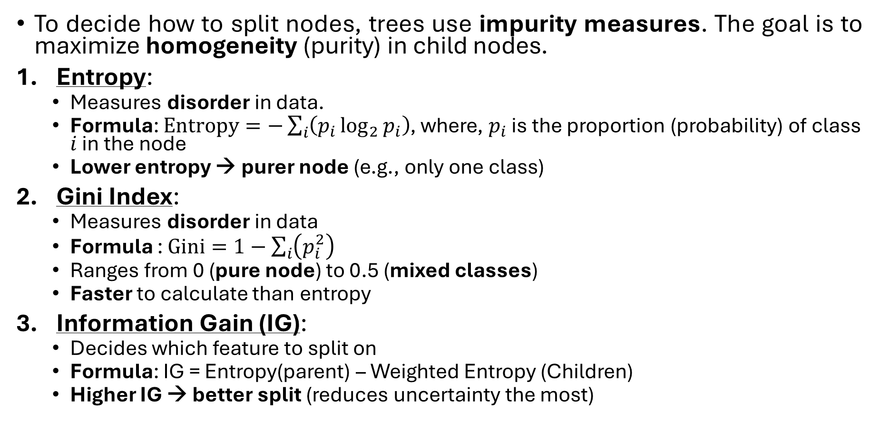
How Splitting Works: Key Criteria
To decide how to split nodes, trees use impurity measures. The goal is to maximize homogeneity (purity) in child nodes.
Entropy:
Measures disorder in data.
Formula: $Entropy=−\sum_{i}{\left(p_{i}\log_{2}{p_{i}}\right)}$, where, $p_{i}$ is the proportion (probability) of class $i$ in the node
Lower entropy → purer node (e.g., only one class)
Gini Index:
Measures disorder in data
Formula : $Gini=1−\sum_{i}{\left(p_{i}^{2}\right)}$
Ranges from 0 (pure node) to 0.5 (mixed classes)
Faster to calculate than entropy
Information Gain (IG):
Decides which feature to split on
Formula: IG = Entropy(parent) – Weighted Entropy (Children)
Higher IG → better split (reduces uncertainty the most)

Slide 6
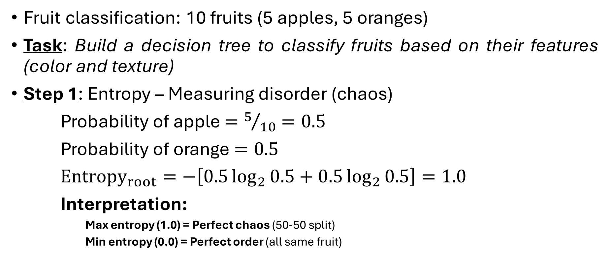
Understanding criteria using an example
Fruit classification: 10 fruits (5 apples, 5 oranges)
Task: Build a decision tree to classify fruits based on their features (color and texture)
Step 1: Entropy – Measuring disorder (chaos)
Probability of apple $=5/{10}=0.5$
Probability of orange $=0.5$
${Entropy}_{root}=−\left[0.5\log_{2}{0.5}+0.5\log_{2}{0.5}\right]=1.0$
Interpretation:
Max entropy (1.0) = Perfect chaos (50-50 split)
Min entropy (0.0) = Perfect order (all same fruit)

Slide 7
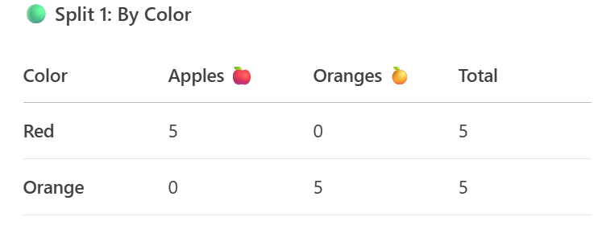
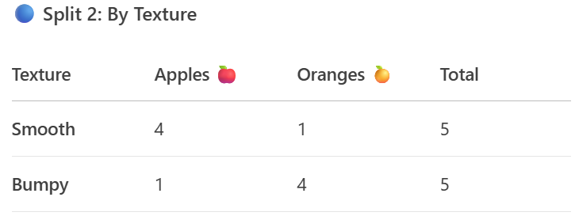
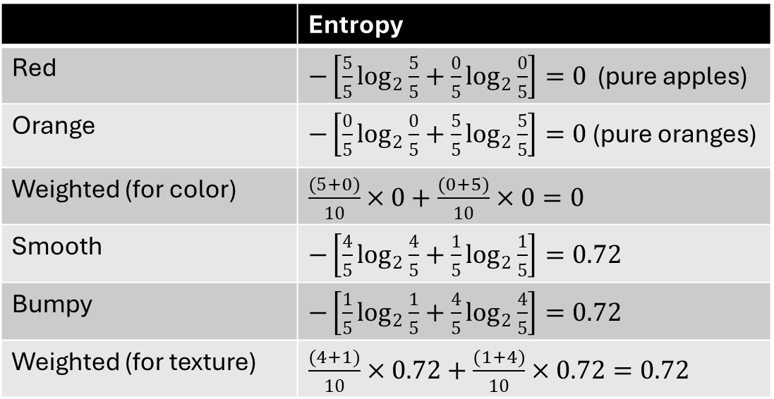
Criteria using an example
Step 2: Splitting the Data
You have two features to split the basket:
Color (Red or Orange)
Texture (Smooth or Bumpy)
 | Entropy
Red | $−\left[\frac{5}{5}\log_{2}{\frac{5}{5}}+\frac{0}{5}\log_{2}{\frac{0}{5}}\right]=0$ (pure apples)
Orange | $−\left[\frac{0}{5}\log_{2}{\frac{0}{5}}+\frac{5}{5}\log_{2}{\frac{5}{5}}\right]=0$ (pure oranges)
Weighted (for color) | $\frac{(5+0)}{10}×0+\frac{(0+5)}{10}×0=0$
Smooth | $−\left[\frac{4}{5}\log_{2}{\frac{4}{5}}+\frac{1}{5}\log_{2}{\frac{1}{5}}\right]=0.72$
Bumpy | $−\left[\frac{1}{5}\log_{2}{\frac{1}{5}}+\frac{4}{5}\log_{2}{\frac{4}{5}}\right]=0.72$
Weighted (for texture) | $\frac{(4+1)}{10}×0.72+\frac{(1+4)}{10}×0.72=0.72$

Slide 8
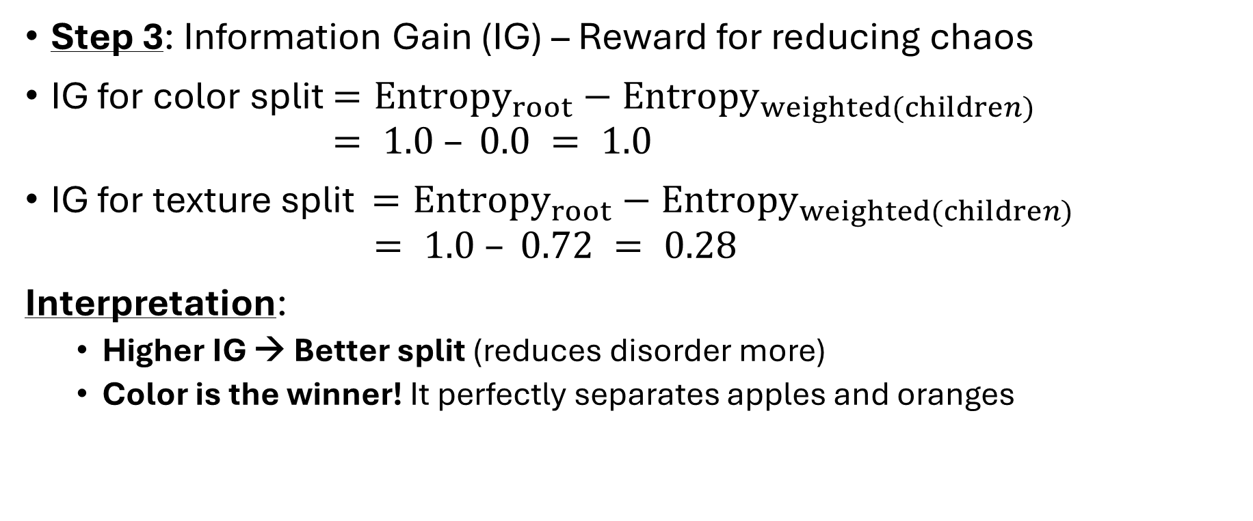
Criteria using an example (contd.)
Step 3: Information Gain (IG) – Reward for reducing chaos
IG for color split $={Entropy}_{root}−{Entropy}_{weighted(children)}$ $= 1.0 – 0.0 = 1.0$
IG for texture split $={Entropy}_{root}−{Entropy}_{weighted(children)}$ $= 1.0 – 0.72 = 0.28$
Interpretation:
Higher IG → Better split (reduces disorder more)
Color is the winner! It perfectly separates apples and oranges

Slide 9

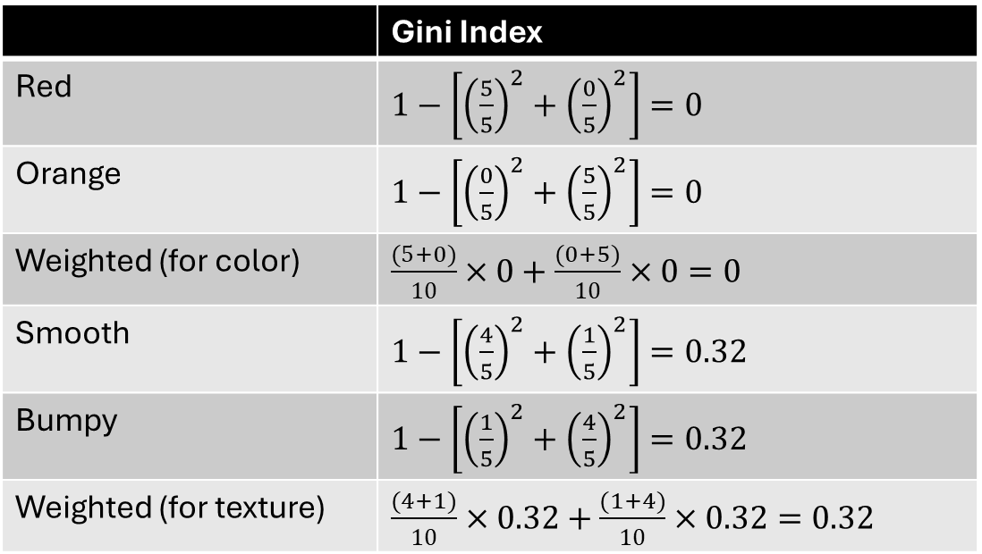
Criteria using an example (contd.)
Step 4: Gini Index - Simpler Impurity
${Gini}_{root} =1−\left[{\left(\frac{5}{10}\right)}^{2}+{\left(\frac{5}{10}\right)}^{2}\right]=0.5$
 | Gini Index
Red | $1−\left[{\left(\frac{5}{5}\right)}^{2}+{\left(\frac{0}{5}\right)}^{2}\right]=0$
Orange | $1−\left[{\left(\frac{0}{5}\right)}^{2}+{\left(\frac{5}{5}\right)}^{2}\right]=0$
Weighted (for color) | $\frac{(5+0)}{10}×0+\frac{(0+5)}{10}×0=0$
Smooth | $1−\left[{\left(\frac{4}{5}\right)}^{2}+{\left(\frac{1}{5}\right)}^{2}\right]=0.32$
Bumpy | $1−\left[{\left(\frac{1}{5}\right)}^{2}+{\left(\frac{4}{5}\right)}^{2}\right]=0.32$
Weighted (for texture) | $\frac{(4+1)}{10}×0.32+\frac{(1+4)}{10}×0.32=0.32$

Slide 10
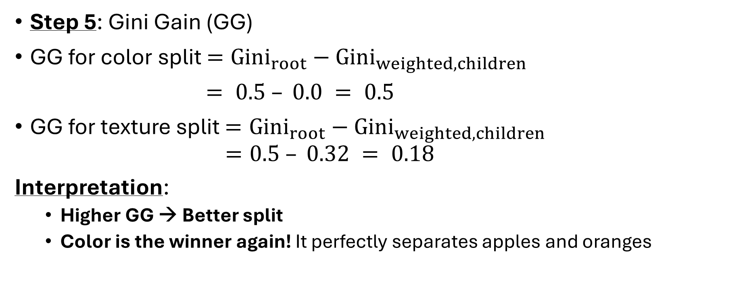
Criteria using an example (contd.)
Step 5: Gini Gain (GG)
GG for color split $={Gini}_{root}−{Gini}_{weighted,children}$
$= 0.5 – 0.0 = 0.5$
GG for texture split $={Gini}_{root}−{Gini}_{weighted,children}$ $=0.5 – 0.32 = 0.18$
Interpretation:
Higher GG → Better split
Color is the winner again! It perfectly separates apples and oranges

Slide 11
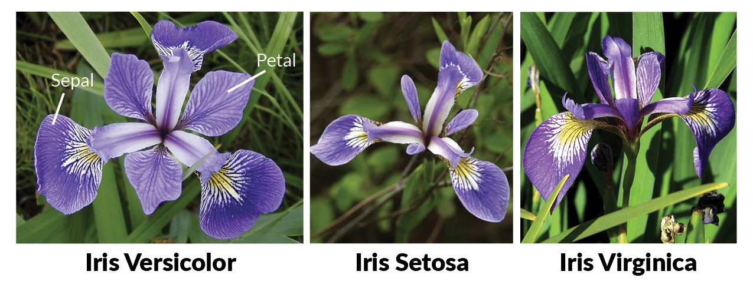
Decision Tree on Iris Dataset: Mathematical Walkthrough
Iris Dataset is one of best know datasets in pattern recognition literature. This dataset contains 3 classes of 50 instances each, where each class refers to a type of iris plant. One class is linearly separable from the other 2 the latter are NOT linearly separable from each other.
Class | Count | Proportion
Setosa | 50 | 1/3
Versicolor | 50 | 1/3
Virginica | 50 | 1/3

Slide 12
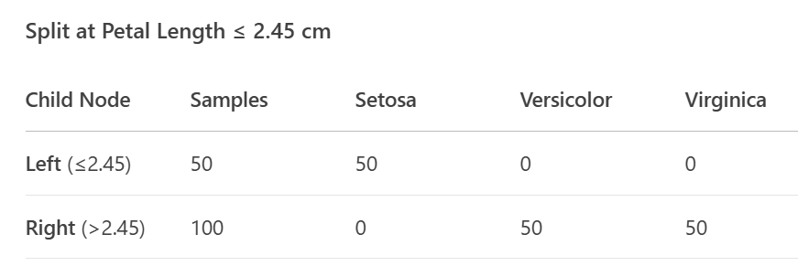

Iris Dataset (contd.)
Step 1: Entropy calculation
$${Entropy}_{root}=−\left[\frac{1}{3}\log_{2}{\frac{1}{3}}+\frac{1}{3}\log_{2}{\frac{1}{3}}+\frac{1}{3}\log_{2}{\frac{1}{3}}\right]=1.585$$
Step 2: Candidate Split on “Petal Length ≤ 2.45 cm“ (a common optimal threshold for the first split)

Slide 13
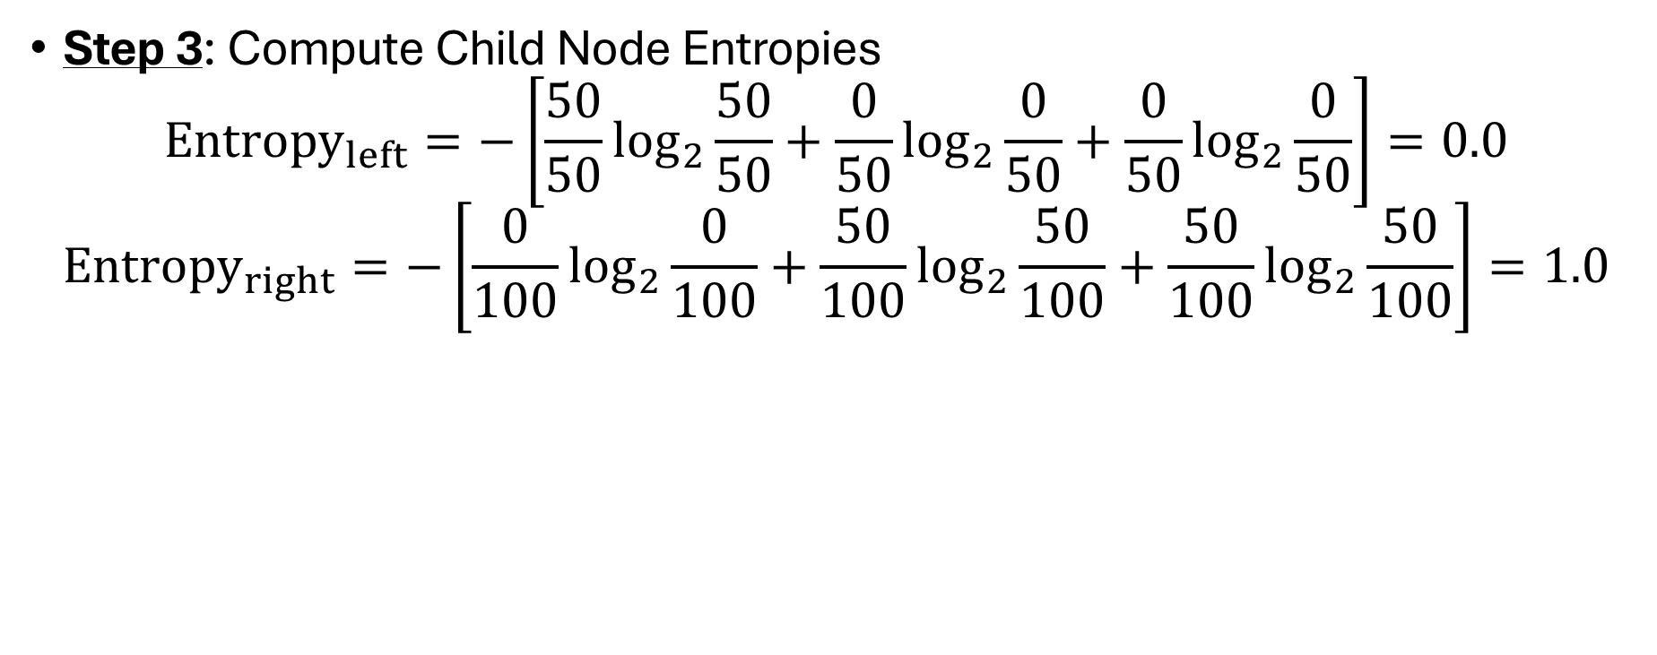
Iris Dataset (contd.)
Step 3: Compute Child Node Entropies
$${Entropy}_{left}=−\left[\frac{50}{50}\log_{2}{\frac{50}{50}}+\frac{0}{50}\log_{2}{\frac{0}{50}}+\frac{0}{50}\log_{2}{\frac{0}{50}}\right]=0.0$$
$${Entropy}_{right}=−\left[\frac{0}{100}\log_{2}{\frac{0}{100}}+\frac{50}{100}\log_{2}{\frac{50}{100}}+\frac{50}{100}\log_{2}{\frac{50}{100}}\right]=1.0$$

Slide 14
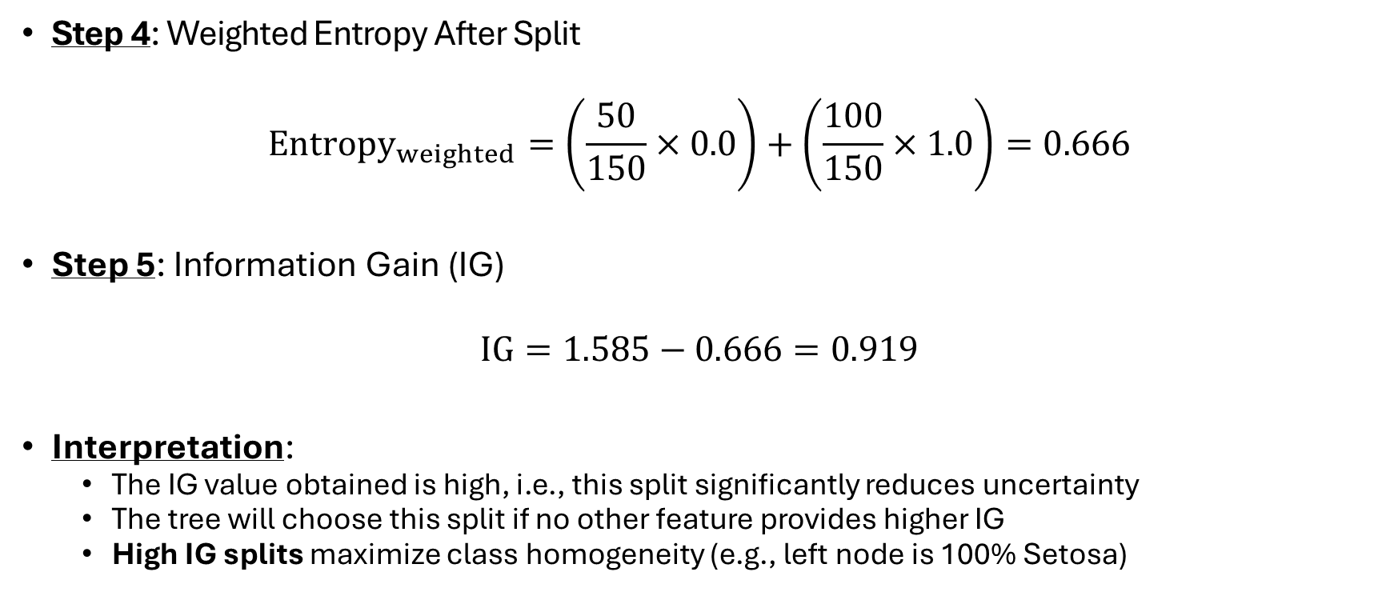
Iris Dataset (contd.)
Step 4: Weighted Entropy After Split
$${Entropy}_{weighted}=\left(\frac{50}{150}×0.0\right)+\left(\frac{100}{150}×1.0\right)=0.666$$
Step 5: Information Gain (IG)
$$IG=1.585−0.666=0.919$$
Interpretation:
The IG value obtained is high, i.e., this split significantly reduces uncertainty
The tree will choose this split if no other feature provides higher IG
High IG splits maximize class homogeneity (e.g., left node is 100% Setosa)

Slide 15
Stopping Criteria
Node is pure (entropy=0)
Maximum tree depth reached
Maximum number of levels in the tree
Prevents deep trees that overfit
IG below minimum threshold
In some tree implementations, a minimum IG threshold can be set to avoid splits that do not improve the model sufficiently (and to prevent overfitting). This threshold is often set by the user.
Minimum Samples per Leaf
Do not split if it results in too few samples in a leaf
Minimum Samples per Split
Do not consider a split unless the node has enough samples

Slide 16
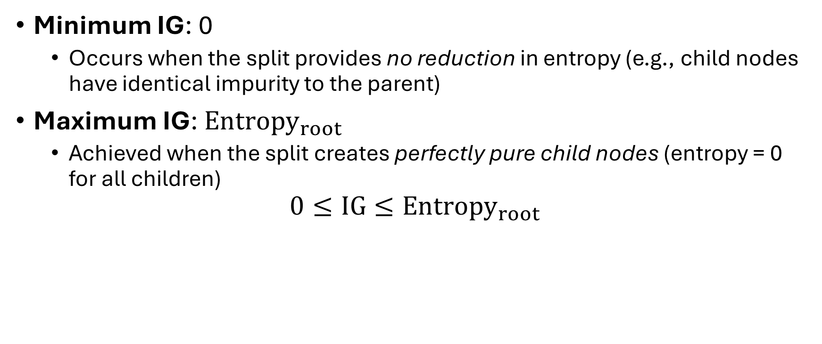
IG Range
Minimum IG: 0
Occurs when the split provides no reduction in entropy (e.g., child nodes have identical impurity to the parent)
Maximum IG: ${Entropy}_{root}$
Achieved when the split creates perfectly pure child nodes (entropy = 0 for all children)
$$0≤IG≤{Entropy}_{root}$$

Slide 17
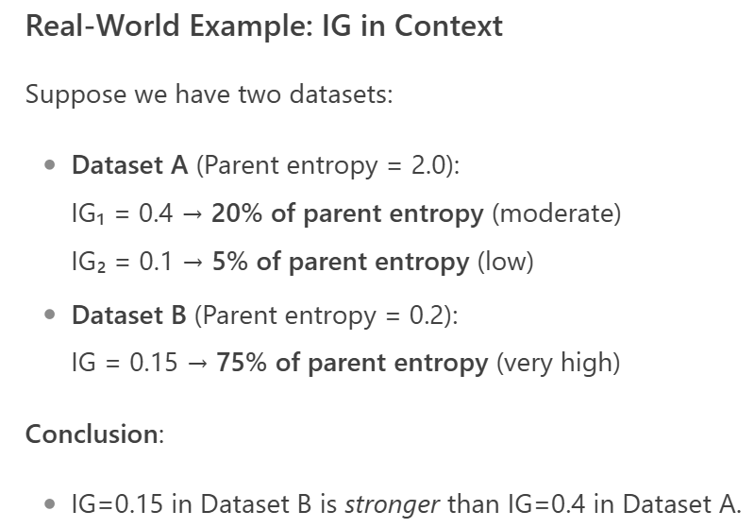
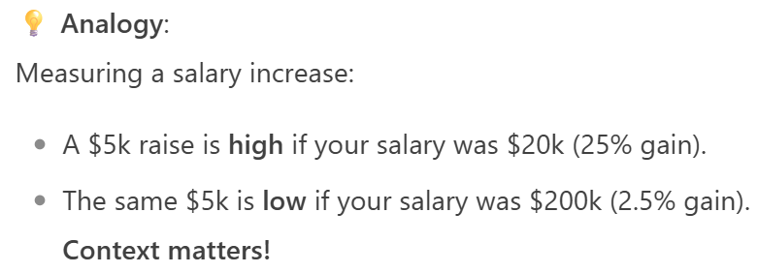
IG Interpretation
Since IG depends on the parent entropy (which varies per dataset/split), we evaluate it relatively
Relative to parent entropy
High IG: IG > 20–30% of parent entropy
Low IG: IG < 5–10% of parent entropy
Example (Iris dataset):
Parent entropy = 1.585
IG = 0.919 → 58% of parent entropy (highly effective split)

Slide 18
IG Interpretation (contd.)
Relative to Other Splits
Decision trees compare IG across all possible splits at a node
The split with the highest IG is chosen
Absolute IG values matter less than their rank
Domain-Specific Thresholds for stopping
Minimum IG threshold: Splits with IG less than the threshold are rejected
Statistical significance: IG should be meaningfully above 0

Slide 19
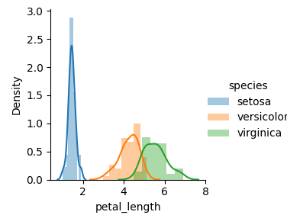
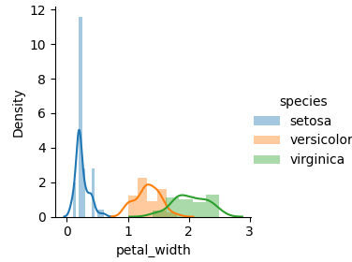
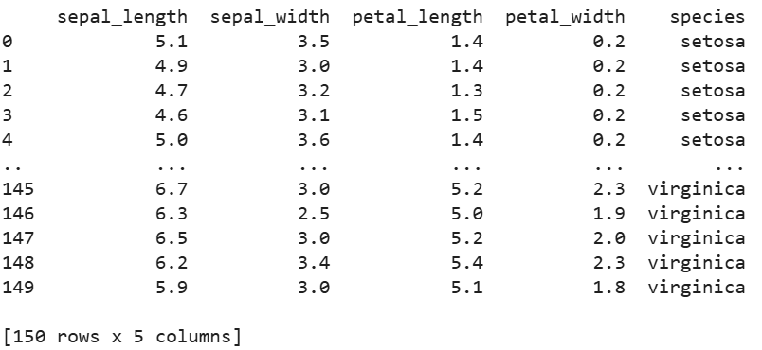
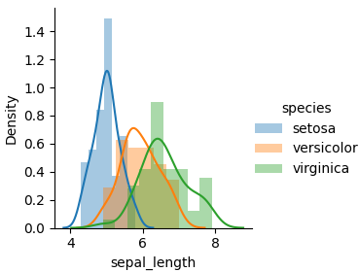
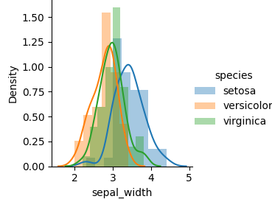
Decision Tree using Sklearn: Iris Dataset
SL SW PL PW

Slide 20
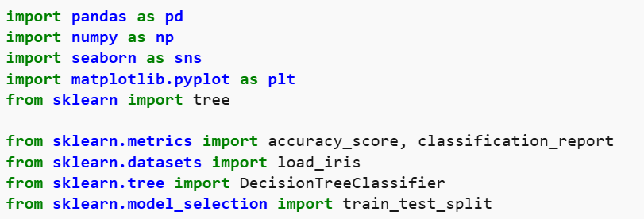

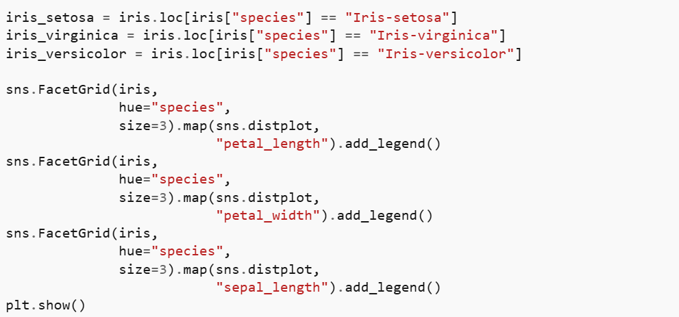
Decision Tree using Sklearn: Python Code
X = iris.iloc[:, :-1]
y = iris.iloc[:,4]
X_train, X_test,\
y_train, y_test = train_test_split(X, y,
test_size=0.33,
random_state=42)
treemodel = DecisionTreeClassifier(criterion='entropy',random_state=0)
treemodel.fit(X_train, y_train)
plt.figure(figsize=(15, 10))
tree.plot_tree(treemodel, filled=True, rounded=True, feature_names=["SL","SW","PL","PW"])
ypred = treemodel.predict(X_test)
score = accuracy_score(ypred, y_test)
print(score)

Slide 21
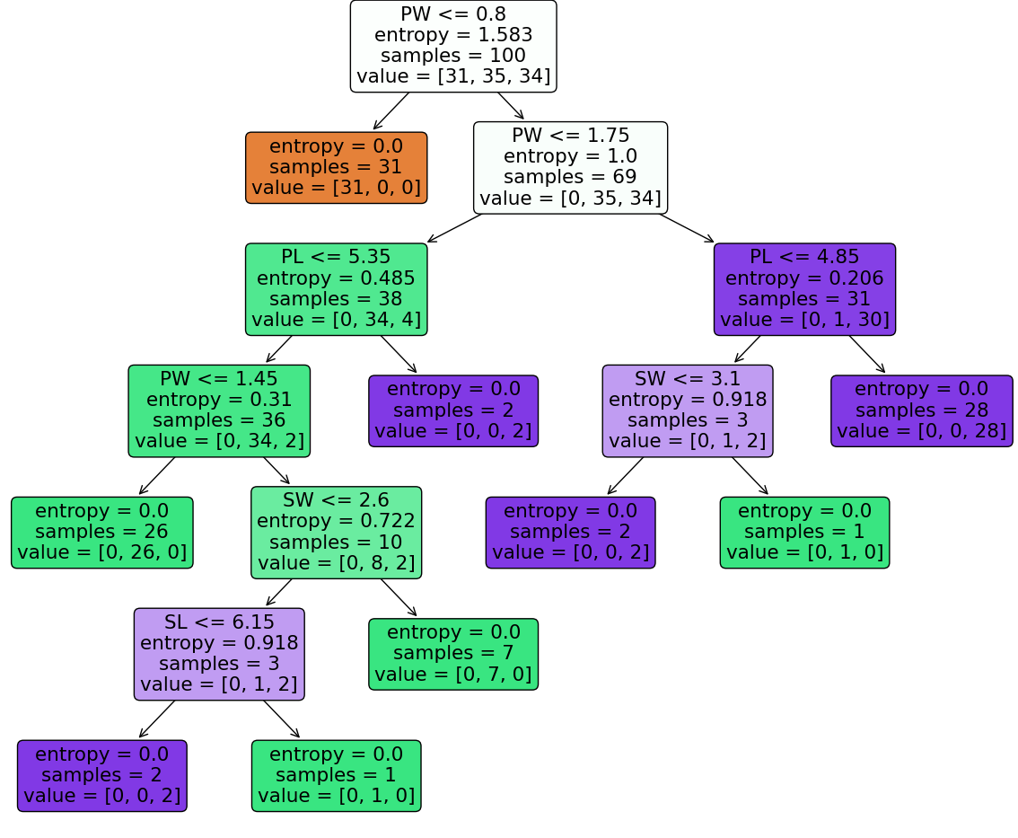
Decision Tree for Iris Dataset
Accuracy on test data: 98%
Figure: Decision tree based on training data

